Slide 1


Inventory Management System
Supervisor - Yogesh Shukla

Slide 2

Team 107
01
02
03
Anant Kumar
Pratik Medhane
Aniketh Pratihar
04
05
06
Akshat Parjapati
Syed Raed Ahmed
Siddharth Singh
20BCE11035
20BCE10312
20BCE10176
20BCE10539
20BCE10541
20BCE10996

Slide 3
Table of Content
Introduction
Problem statement
Objective
Implementation Code and Explanation
Models and Diagram
Outcomes Conclusion and limitation

Slide 4

Introduction
The Inventory Management System is an app that maintains and tracks your product supply as well as inventory control.
This software maintains products by entering information such as name, product id, buy rate, and product description.

Slide 5


Problem Statement
The inventory management system is an essential component of any business that deals with products.
It involves tracking and managing the flow of goods and materials from the point of purchase to the point of sale. The manual process of inventory management can be time-consuming and prone to errors.
The lack of a proper system for tracking inventory levels can lead to stockouts, excess inventory, and inefficient allocation of resources.
Inventory Management System

Slide 6
The objective of inventory management is to understand stock levels and stock's location in warehouses. Inventory management software tracks the flow of products from supplier through the production process to the customer. In the warehouse, inventory management tracks stock receipt, picking, packing and shipping.
To optimize various costs indulged with inventories like purchase cost, carrying a cost, storage cost, etc. To keep material cost under control as they contribute to reducing the cost of production. To eliminate duplication in ordering stocks. To minimize loss through deterioration, pilferage, wastages, and damages.
OBJECTIVE

Slide 7
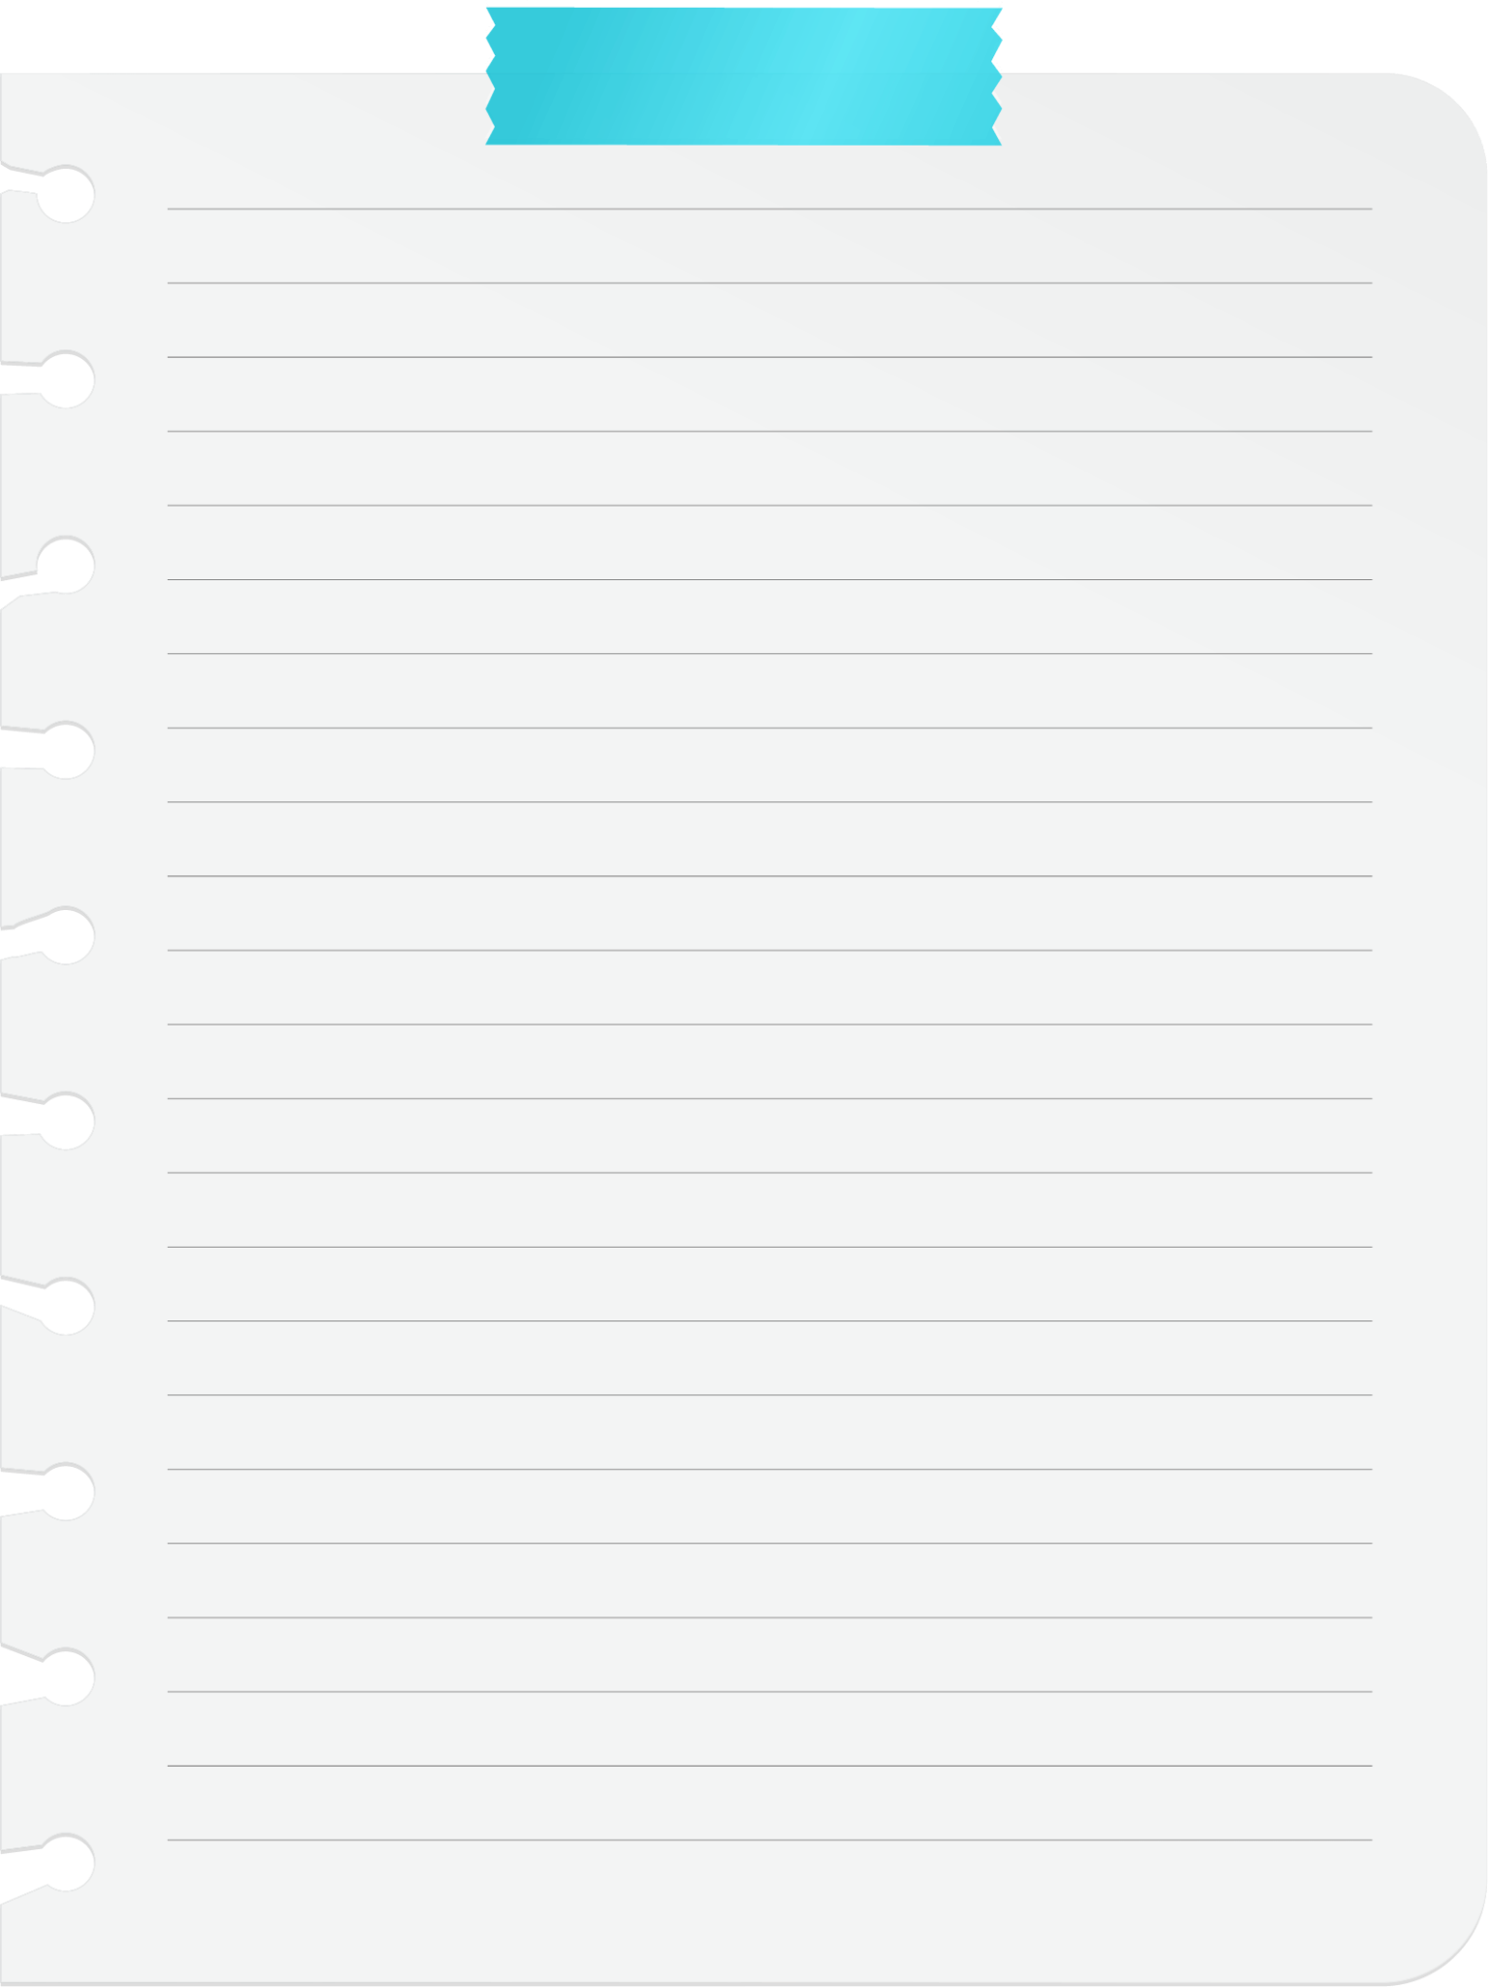
THE IMPLEMENTATION
The prototype application is implemented using Java and Firebase for database.
The prototype allows the user to upload the details of the product such as price, product name, product category, product barcode if available on the database and delete the data as per need.
On successful registration by the user, he/she can log into the application and view the dashboard where user can add product ,delete product or view all the added items.

Slide 8
CONNECT TO DATABASE

Slide 9
public class User { public String product_name,category,price,itembarcode; public User() { } public User(String product_name, String category, Stringprice,String itembarcode) { this.product_name = product_name; this.category = category; this.price = price; this.itembarcode = itembarcode; } public String getItembarcode() { return itembarcode; } public String getProduct_name() { return product_name; } public String getCategory() { return category; } public String getPrice() { return price; } }

Slide 10
public class View_inventory_Adapter extends FirebaseRecyclerAdapter<User, View_inventory_Adapter.View_inventoryHolder> { public View_inventory_Adapter(@NonNull FirebaseRecyclerOptions<User> options) { super(options); } @Override protected void onBindViewHolder(@NonNull View_inventoryHolder holder, int position, @NonNull User model) { holder.item_name_view.setText(model.getProduct_name()); holder.item_category_view.setText(model.getCategory()); holder.item_price_view.setText(model.getPrice()); holder.itembarcodesd.setText(model.getItembarcode()); } @NonNull @Override public View_inventoryHolder onCreateViewHolder(@NonNull ViewGroup parent, int viewType) { View view = LayoutInflater.from(parent.getContext()) .inflate(R.layout.view_inventory_dummy_list, parent, false); return new View_inventoryHolder(view); } class View_inventoryHolder extends RecyclerView.ViewHolder{ TextView item_name_view,item_category_view,item_price_view,itembarcodesd; public View_inventoryHolder(@NonNull View itemView) { super(itemView); item_name_view = itemView.findViewById(R.id.viewitemname); item_category_view = itemView.findViewById(R.id.viewitemcategory); item_price_view = itemView.findViewById(R.id.viewitemprice); itembarcodesd = itemView.findViewById(R.id.viewitembarcoden); } } }

Slide 11
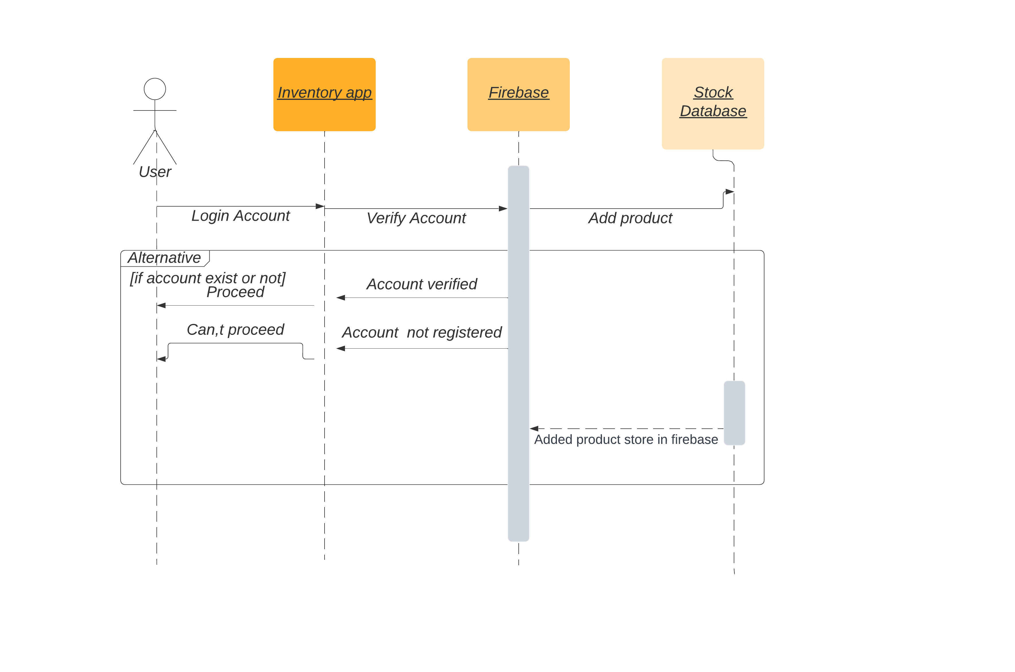
MODELS & DIAGRAM

Slide 12
In the onCreate() method, initialize the FirebaseAuth instance.
mAuth =FirebaseAuth.getInstance();
databaseReference=FirebaseDatabase.getInstance().getReference("User");
Now set the pojo class data to recycle view
adapter = new View_inventory_Adapter(options);
recyclerView.setAdapter(adapter);

Slide 13
login.setOnClickListener(new View.OnClickListener() {
@Override
public void onClick(View view) {
login_to_next_activity();
}
private void login_to_next_activity() {
String email = editTextEmail.getText().toString();
String password = editTextPassword.getText().toString().trim();
if (!email.matches(emailPattern))
{
editTextEmail.setError("Enter correct Email");
editTextEmail.requestFocus();
}
else if (password.isEmpty()||password.length()<6)
{
editTextPassword.setError("Enter Proper Password");
editTextPassword.requestFocus();
}

Slide 14
else {
progressDialog.setMessage("Please wait while Login ");
progressDialog.setTitle("Login");
progressDialog.setCanceledOnTouchOutside(false);
progressDialog.show();
mAuth.signInWithEmailAndPassword(email,password).addOnCompleteListener(new OnCompleteListener<AuthResult>() {
@Override
public void onComplete(@NonNull Task<AuthResult> task) {
if (task.isSuccessful()){
progressDialog.dismiss();
Intent intent = new Intent(LoginActivity.this,Dashboard_Activity.class);
String gm = editTextEmail.getText().toString();
intent.putExtra("gmail",gm);
intent.setFlags(Intent.FLAG_ACTIVITY_CLEAR_TASK|Intent.FLAG_ACTIVITY_NEW_TASK);
startActivity(intent);
finish();
Toast.makeText(LoginActivity.this, "Login Successful", Toast.LENGTH_SHORT).show();
}
else
{
progressDialog.dismiss();
Toast.makeText(LoginActivity.this, "Login Failed"+task.getException(), Toast.LENGTH_SHORT).show();
}
}
});
}
}
});

Slide 15
Bug Fixing

Slide 16
Bug fixing in Android apps typically involves identifying and resolving issues or errors that affect the app's functionality, performance, or user experience.
Debugging Tools: Utilize Android Studio's built-in debugging tools like logcat, breakpoints, and the debugger to analyze the code execution and track down the bug's root cause.
Log Analysis: Examine the logs generated by the app to identify any error messages, exceptions, or unexpected behaviors. These logs can provide valuable insights into the bug's source.
Code Review: Review the relevant code sections, paying attention to logic errors, incorrect data handling, null pointer references, or other potential issues. Compare the code against the intended behavior to spot any discrepancies.

Slide 17
Fixing the Bug: Apply the necessary modifications to the code to address the bug. This might involve correcting logical errors, adjusting data structures, handling exceptions, or optimizing performance.
Testing: After making the changes, thoroughly test the app to ensure the bug has been successfully resolved and doesn't introduce any new issues. Test on various devices, screen sizes, and Android versions.
Regression Testing: As you fix a bug, it's essential to retest previously working features to ensure that the fix hasn't caused any regressions or unintended side effects elsewhere in the app.

Slide 18

OUTCOME

Slide 19
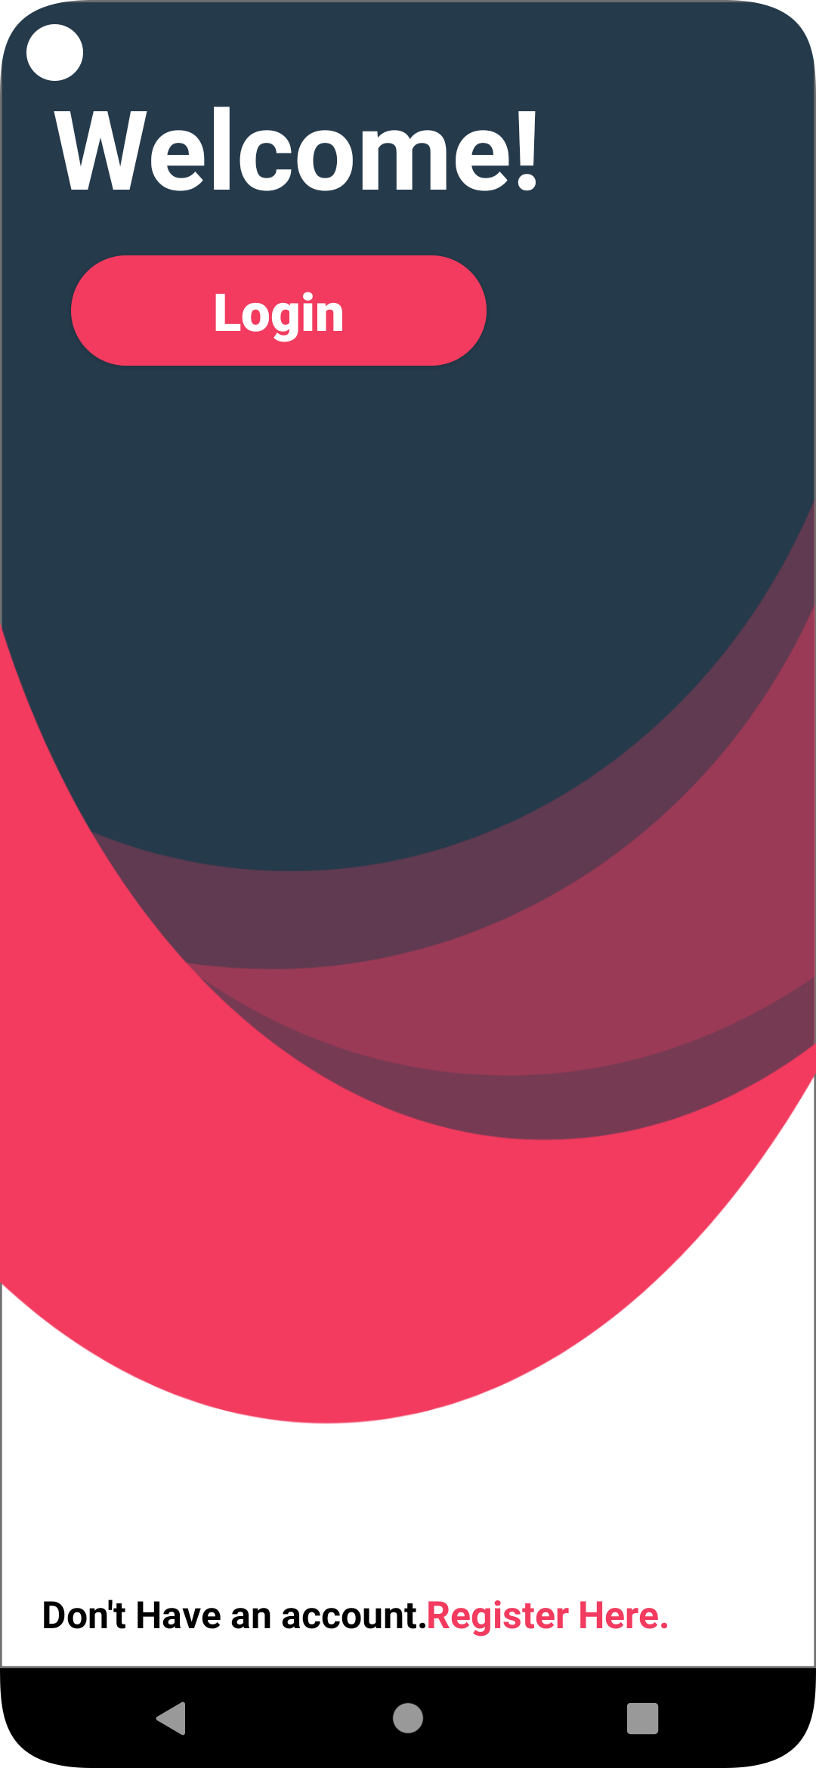
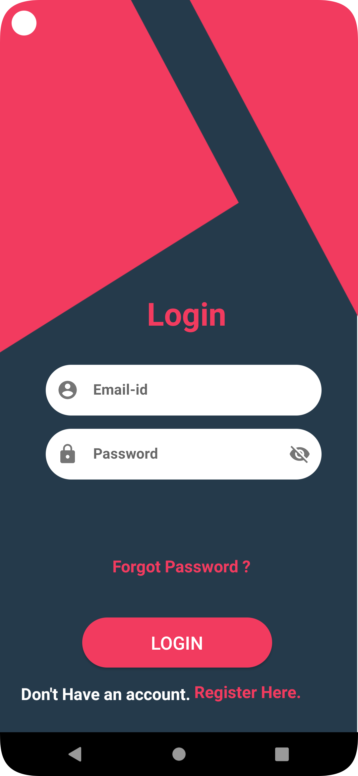
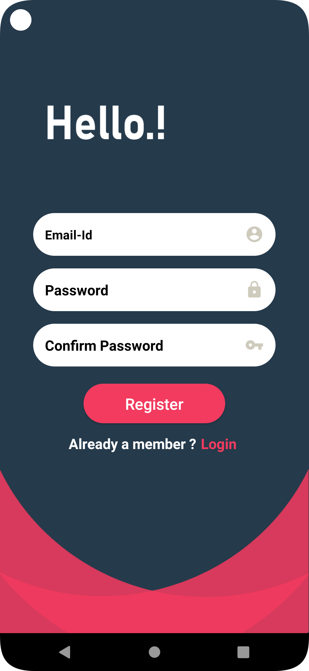
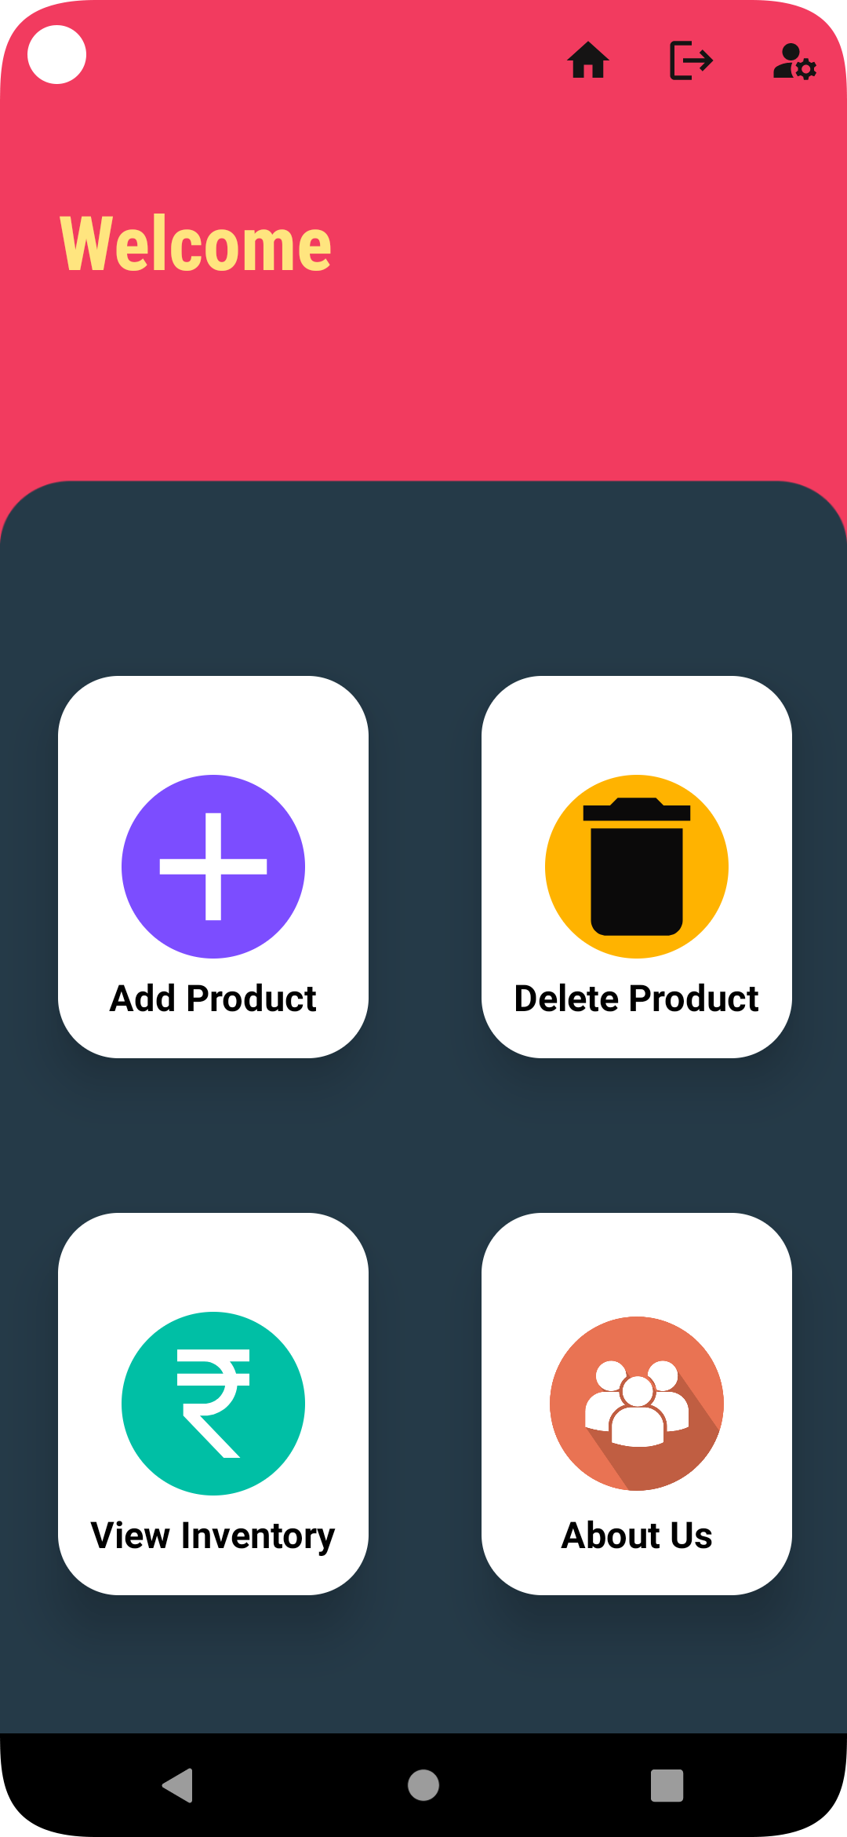

Slide 20
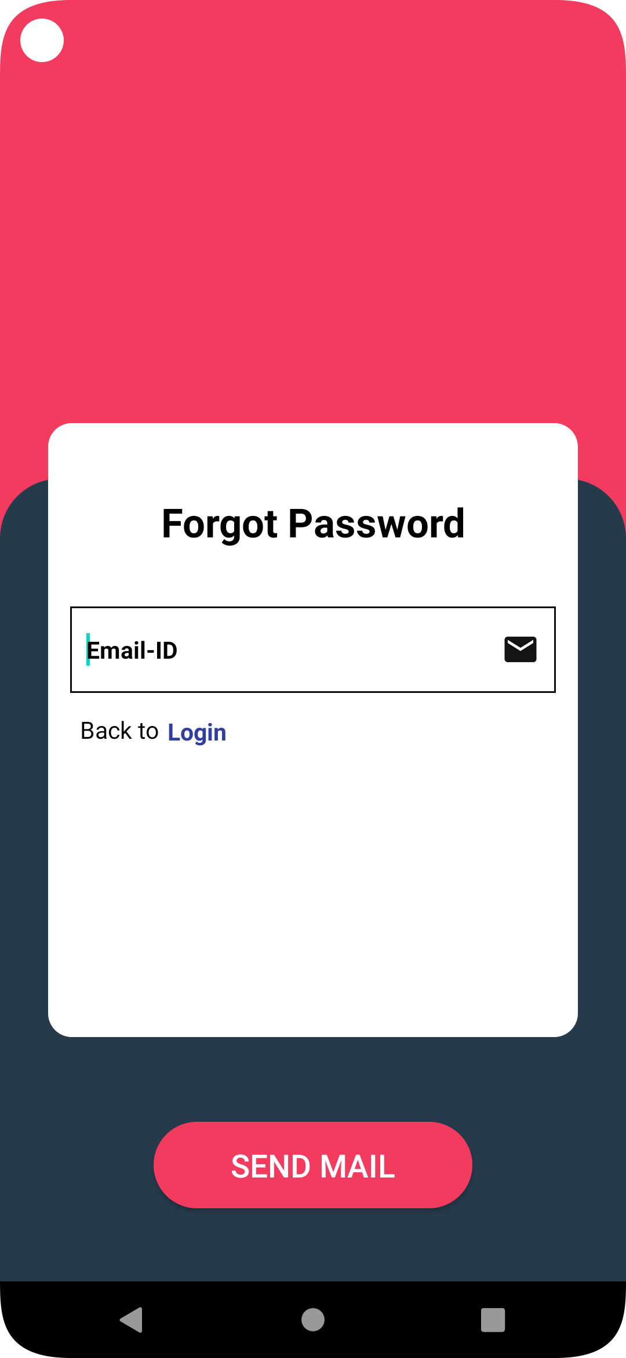
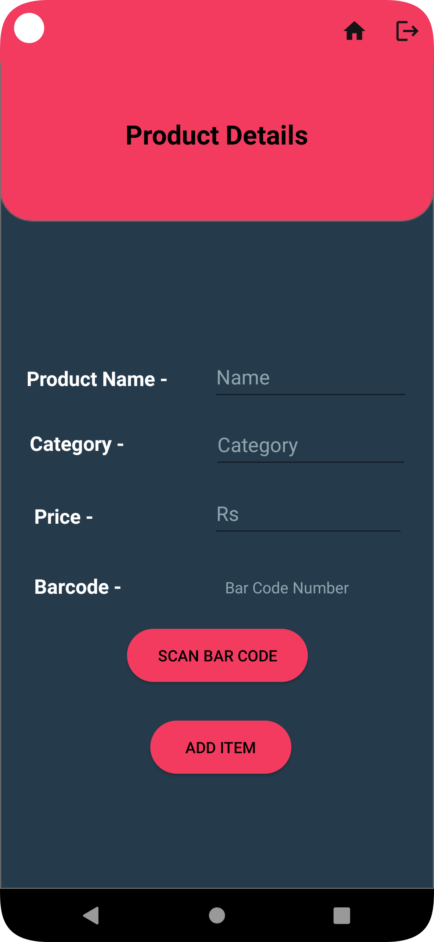
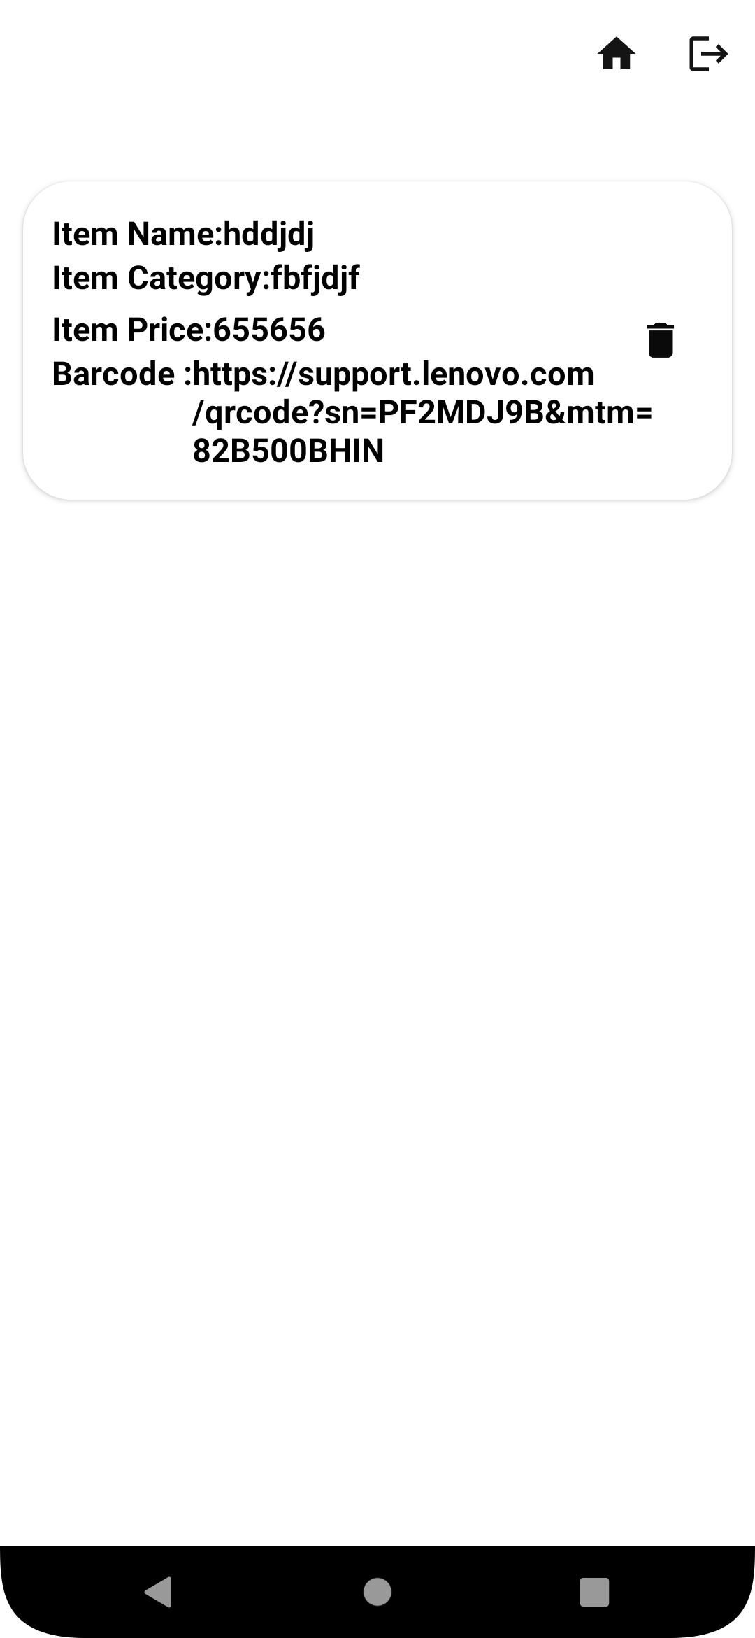

Slide 21
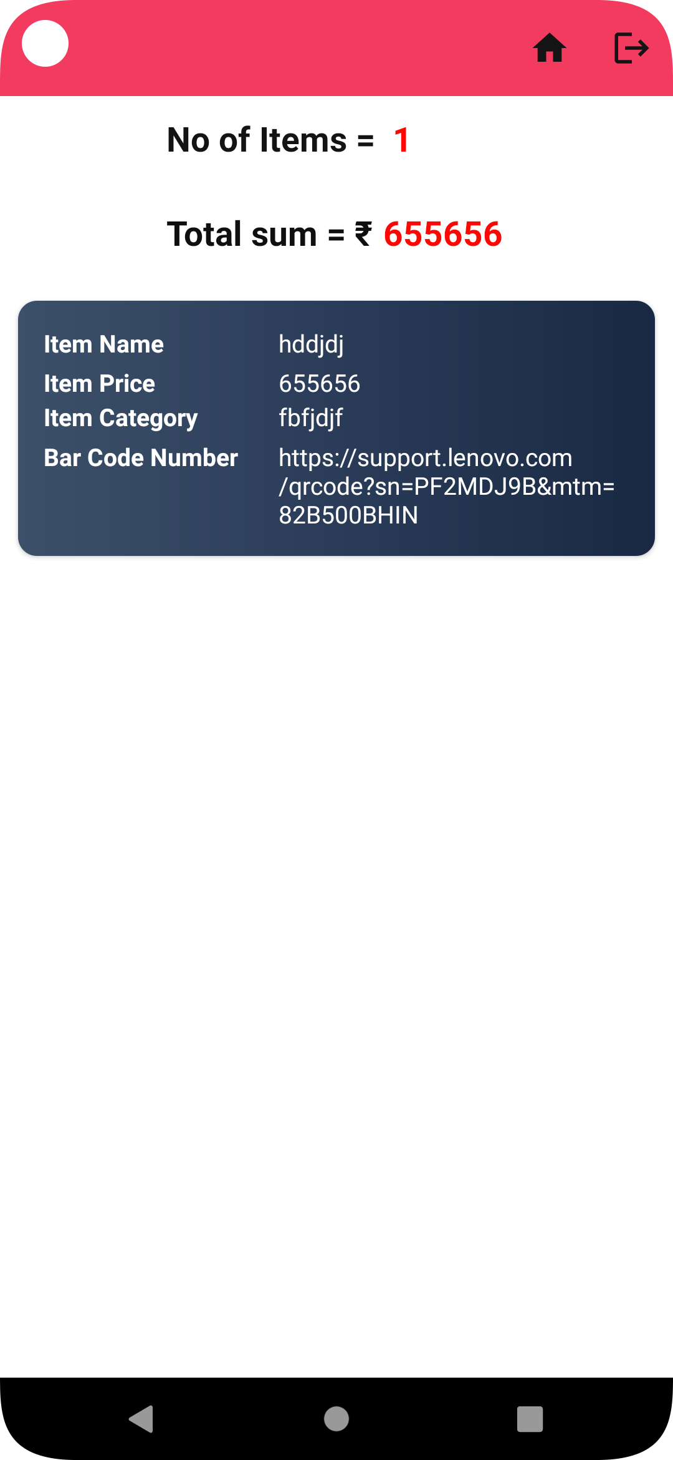
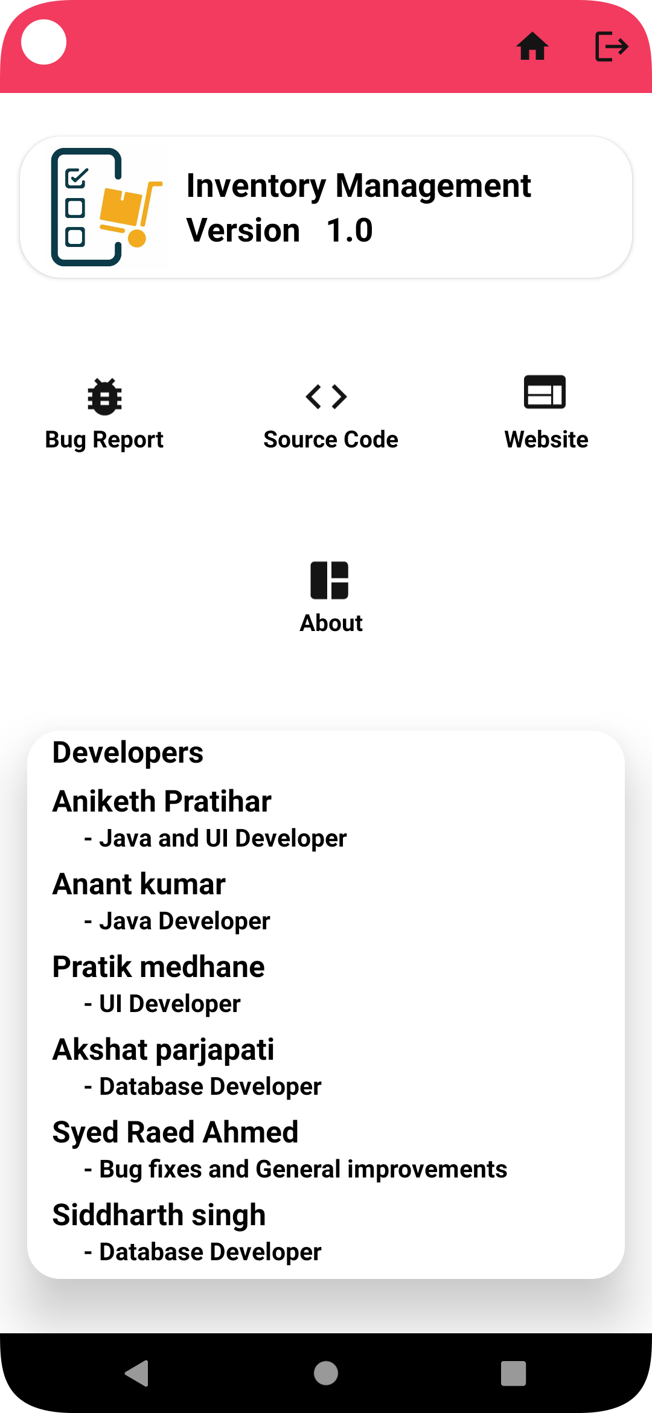
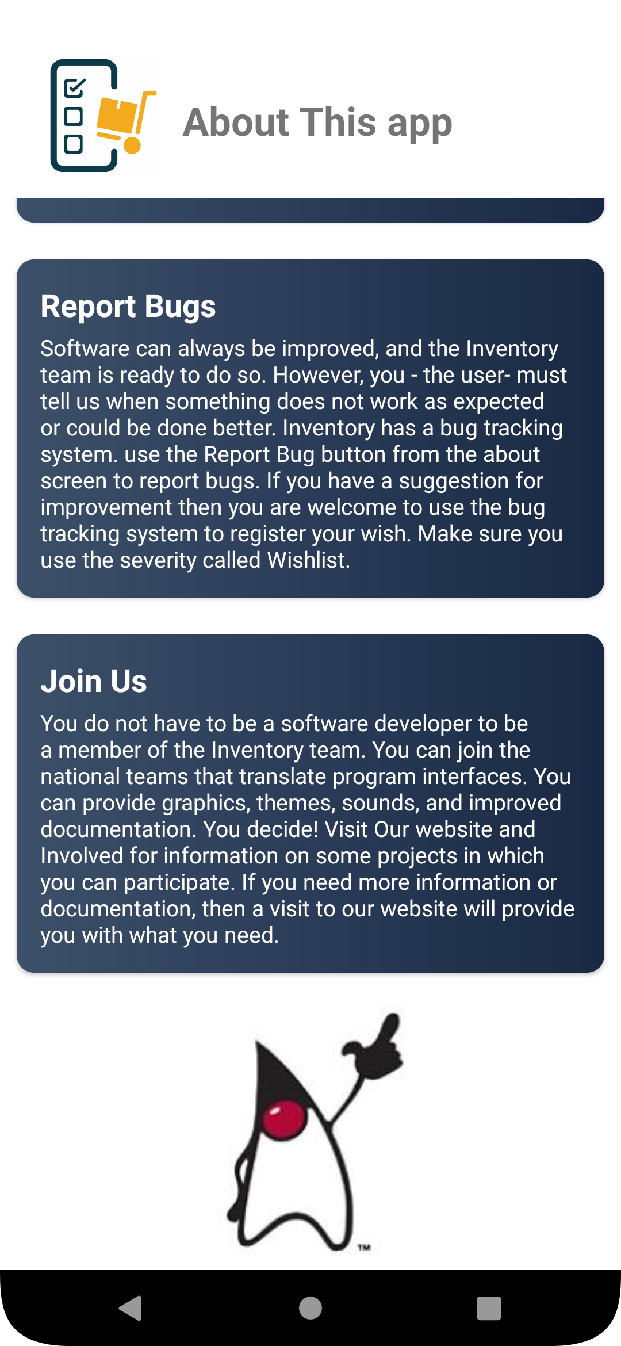

Slide 22
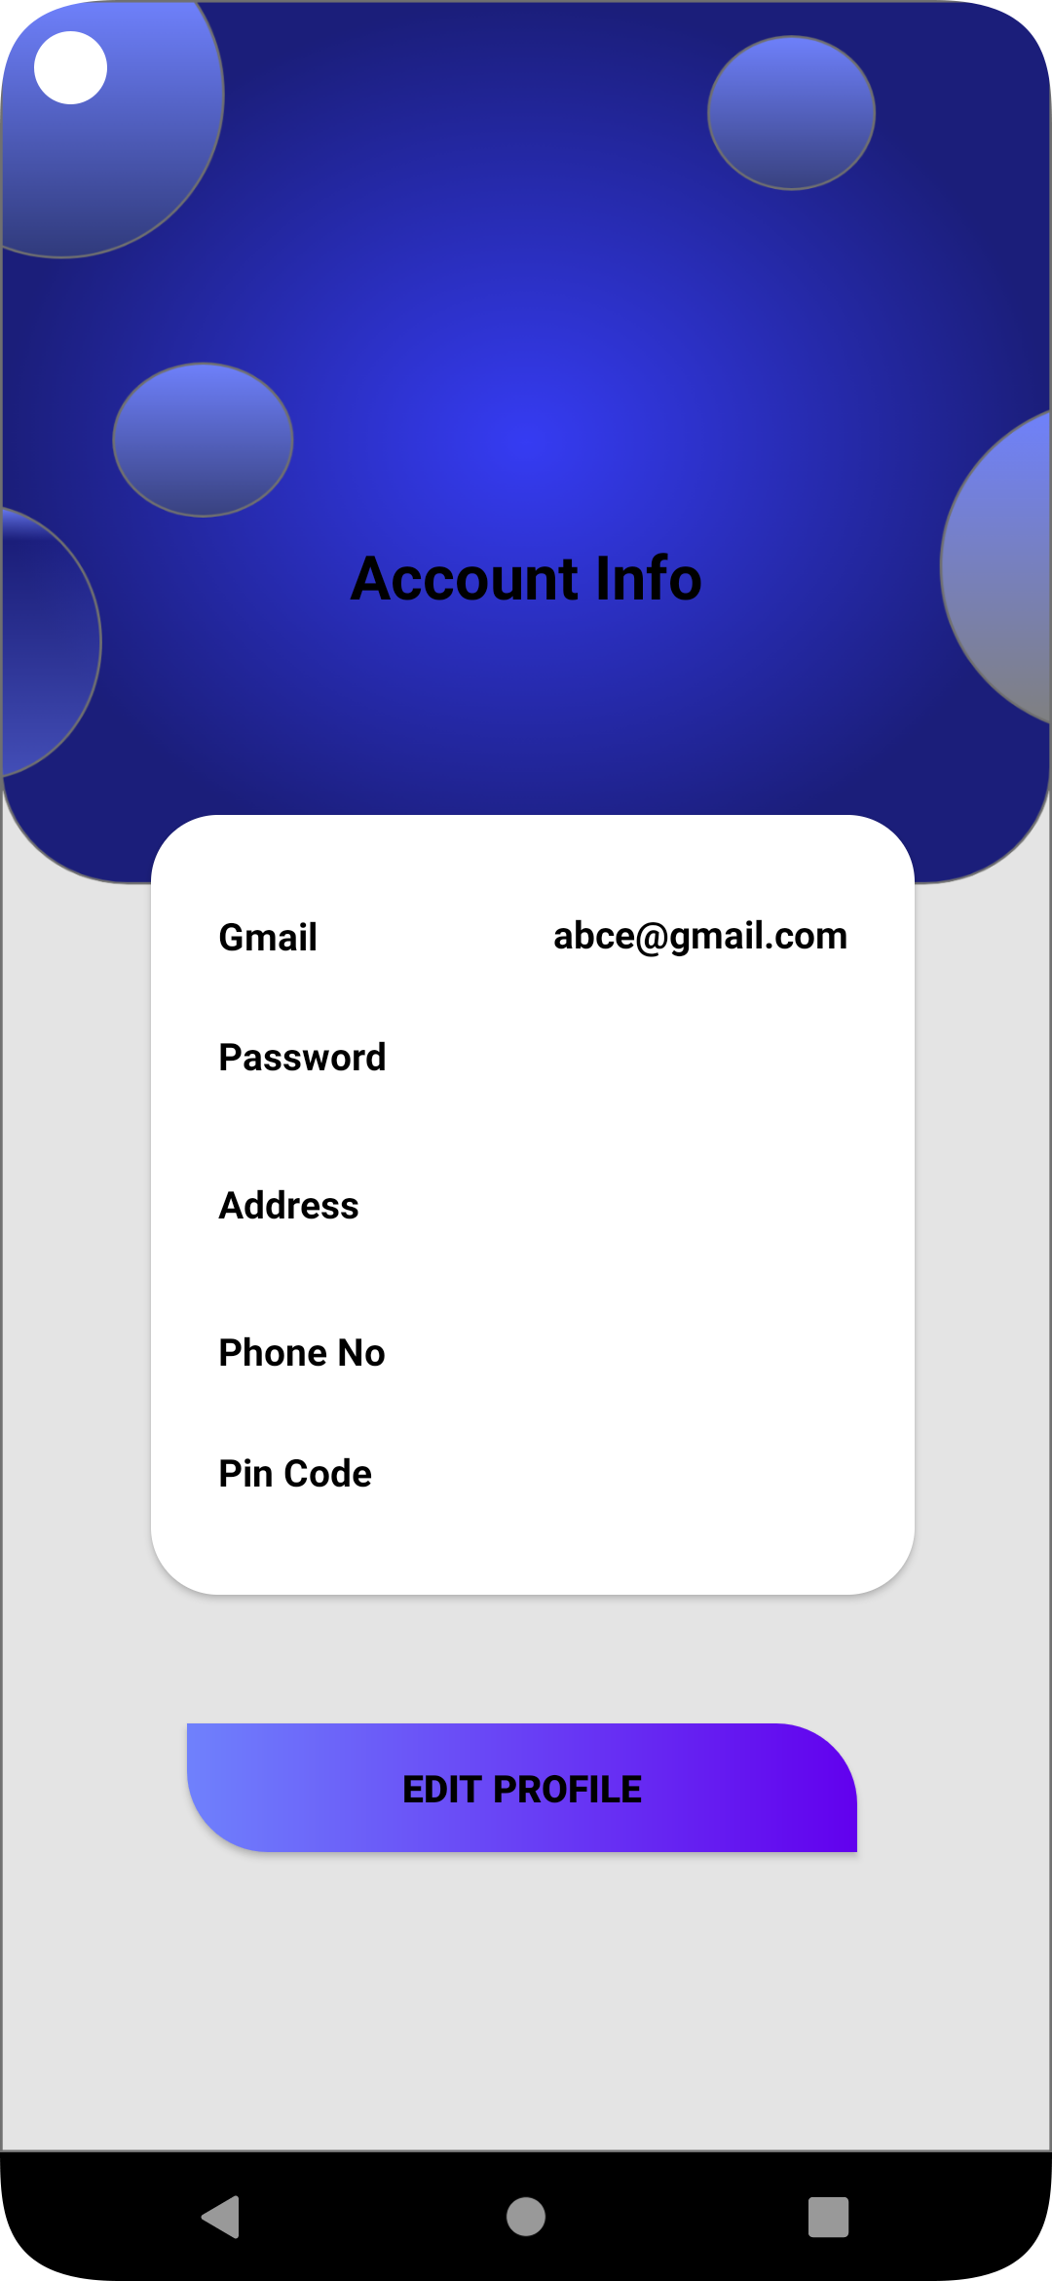

Slide 23

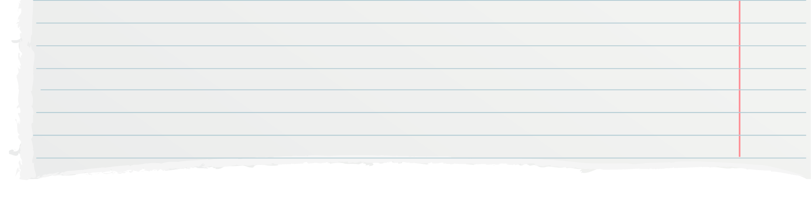
CONCLUSION AND LIMIT
Thus, our app tries to comfort its users with easily understandable as well as essential functionalities. User can add product details . Our app is implemented to help manage the affairs of a small vendor or shop in society by entering the minimal amount of information. Thus, this app provides a small overview of the shop inventory. ​
The limitation is As of now we are not using third-party libraries, such as direct Google Sign-In, to simplify the login process, do not configure the forget password, also it will not store the login details that's why every time we have to enter email-id and password to login.

Slide 24
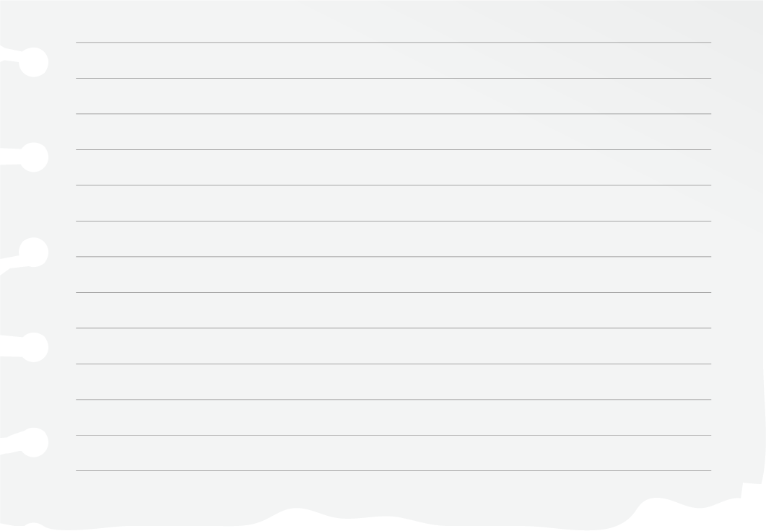
Thank you!

